Slide 1
Energy Systems and Exercise

Slide 2

Objectives of Today’s Lesson
Define the terms energy, aerobic, anaerobic
Compare and contrast the 3 main energy systems used during exercise
Identify the predominant energy system that is used during different types of exercise or sports activities
Explain the process of aerobic metabolism of carbohydrates, fats, and protein and the concept of measuring fuel utilization

Slide 3
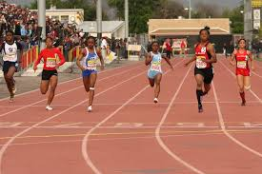
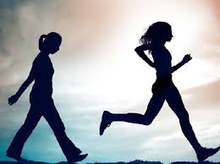
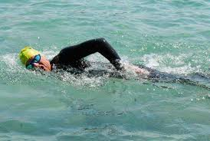
Basic Definitions
Energy: The capacity to do work
Aerobic: Oxygen is available and physical activity (PA) is a low- to moderate intensity
Ex: walking /jogging or swimming longer distances
Anaerobic: Oxygen is very limited and PA is intense
Ex: 100-dash

Slide 4
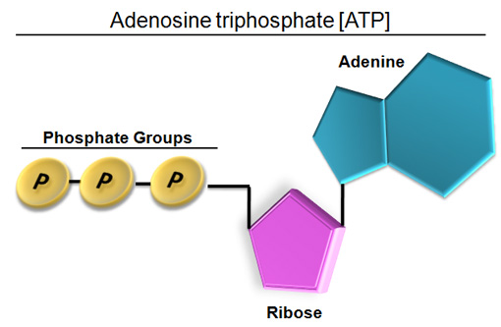
ATP is the Immediate Source of Energy in the Body for Activity and Exercise
Adenosine Tri-Phosphate (ATP)
Stores potential energy in phosphate bonds
When broken down to ADP, can release energy to be used for a wide variety of tasks by the muscle
Found in ALL of the body
How do we restore ATP after it is used?
Constantly turning over

Slide 5

Rephosphorylation of ATP from ADP is needed to restore it
To rephosphorylate ATP a phosphate group is joined to ADP to re-form ATP
Endergonic process that requires the input energy
ADP
Energy
ATP
PI

Slide 6
Three Main Energy Systems replenish ATP, the Body’s Direct Source of Energy During Exercise and at Rest
During exercise or a sports activity, all 3 energy systems are “ON”
In certain exercise or sports activities, one of the energy systems maybe the more predominant energy system used during that activity
ATP
Creatine phosphate
Anaerobic glycolysis
Oxidative phosphorylation

Slide 7
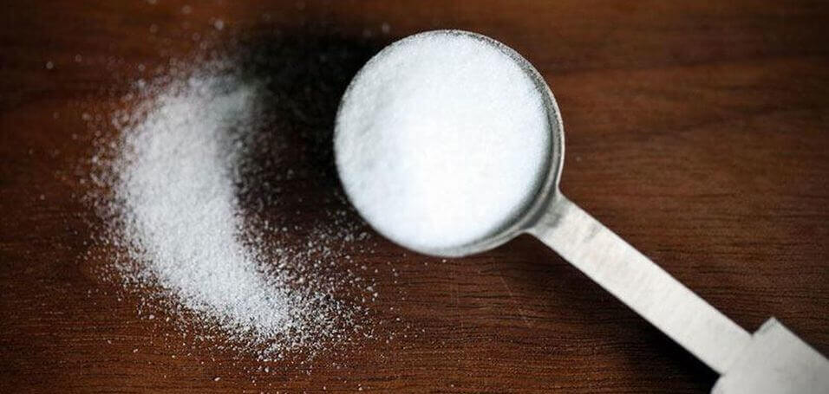
Creatine Phosphate Energy System
Creatine Phosphate (CrP) is another high-energy phosphate compound stored in the muscle + other tissues
Energy released from breakdown of CrP is used to restore ATP
Where do we get Creatine in the diet?
Food sources-beef and fish
Dietary supplements
Liver and kidney can synthesize creatine if amino acids (arginine, glycine, and methionine are present)
Issues with vegetarians?

Slide 8
Creatine Phosphate Energy System, contd.
Creatine phosphate energy system phosphorylates ADP into ATP very RAPIDLY
One-step chemical reaction catalyzed by the creatine kinase (CK) enzyme
Reaction does not require oxygen (anaerobic) energy systems
Preferred energy system during very-high intensity, but short-duration exercise

Slide 9

Critical thinking-What types of exercise or sports activities would utilize the Creatine Phosphate Energy System?

Slide 10
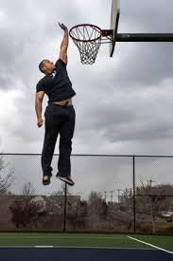

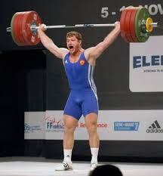
Answer: Very high-intensity, but Short-duration exercise or sports activities
Short, fast sprints, 100-meter sprint in track or 40- yard sprint in football
Activities requiring large amounts of force like heavy weight lifting or an Olympic lift
Short, powerful bursts of activity like the shot put or jumping to dunk a basketball

Slide 11
The Anaerobic Glycolysis Energy System
“The process of taking carbohydrates in the body and putting it through a series of chemical reactions that release energy to re-form ATP, final product of this series of chemical reactions in lactic acid”

Slide 12
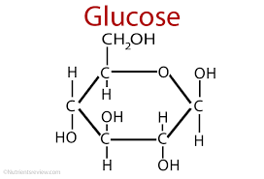
The Anaerobic Glycolysis Energy System, contd.
Main points to know
Carbohydrates -> glucose
Glucose can be stored in the muscle and liver for later use
Glycolysis is the process of breaking down glucose through many steps to phosphorylate ADP and form ATP
Oxygen is not required for reactions to proceed anaerobic
Start with glucose, end up with lactate what is the fate of lactate
When glycogen is broken down the process is called glycogenolysis

Slide 13
Critical thinking-What types of exercise or sports activities would utilize the Anaerobic Glycolysis Energy System?

Slide 14

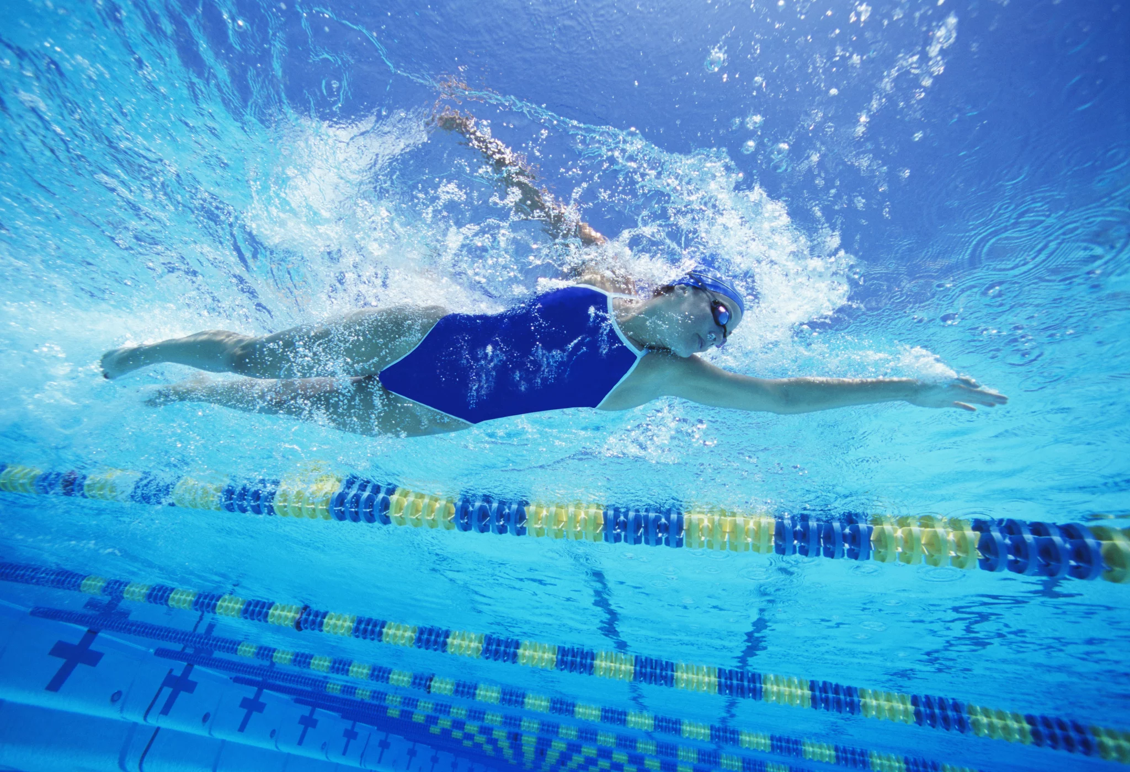
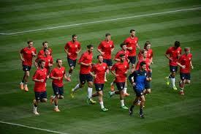
Answer: High-intensity exercise becomes the predominant energy system after 5-10 seconds when the Creatine Phosphate System reaches its limit
Long sprints, think the 400-meter sprint in tract or repeated intermittent sprints by a soccer player
Regular, repeated intervals such as 50-100 meter swimming intervals
Repeated, high-force activities such as 10-15 repetitions of weight lifting

Slide 15
The Oxidative Phosphorylation Energy System
AKA aerobic energy system , supplies ATP on a continuous basis
A process by which carbs, fats, and protein can be metabolized through a series of reactions to release energy to phosphorylate ADP to ATP
Takes place in the mitochondria in 3 phases glycolysis, Kerbs Cycle , electron transport chain – see figure 3.17 in your book
In the ETC, the final electron acceptor is oxygen making this an aerobic energy system
Net ATP production is 30-32

Slide 16
Critical thinking-What types of exercise or sports activities would utilize the Oxidative Phosphorylation Energy System?

Slide 17
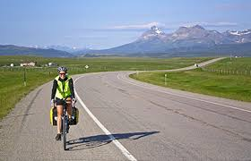
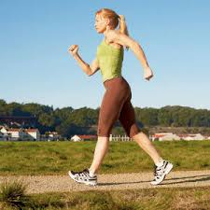

Answer: Used at rest and to Support Low to Moderate-Intensity Exercise
Walking , jogging or distance running
Long – distance swimming or dance aerobics
Cycling longer distances, not spring cycling

Slide 18
Summary of Main Characteristics of the 3 Energy Systems
Creatine Phosphate System
One chemical step
Very fast reaction
One ATP per CrP molecule
Catalyzed by creatine kinase (CK) enzyme
Anaerobic
Predominant energy system in very high-intensity exercise and “power” events
Anaerobic Glycolysis System
Many chemical steps/reactions~18
2 ATP made for glucose/3 for glycogen
Phosphofructokinase enzyme
Fast, but not as fast as CrP system
Anaerobic
Predominant energy system in high-intensity exercise
Oxidative Phosphorylation System
Many chemical steps/reactions ~124
30-32 ATP made via glucose/glycogen
Several enzymes involved
Slower system
Aerobic
Predominant energy system in low to moderate/endurance exercise

Slide 19
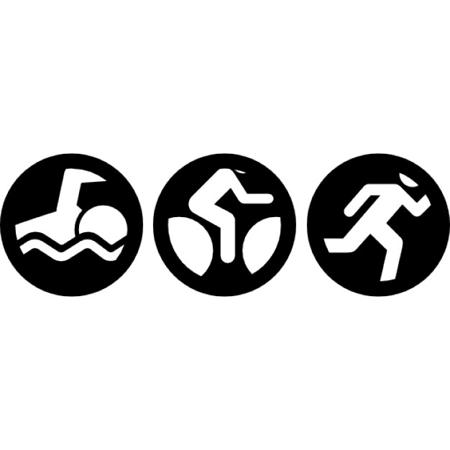
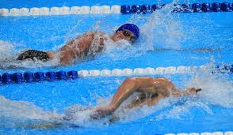
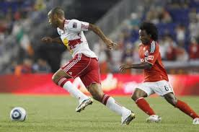
Application Exercise
Examine each of the exercise or sports scenarios below and determine the utilization of each of the 3 main energy systems during that activity. Is there one system that is the predominant source of energy (ATP) replacement?
1. A triathlete completes an Ironman Triathlon.
2. An Olympic swimmer swims in a 200-meter freestyle race.
3. A soccer midfielder runs back and forth alternately playing offense and defense as the teams change possession of the ball.
https://www.youtube.com/watch?v=pB_J4VlBaaM&list=PLPaqTlkFlojSS4cALaasDe2boy7KcZTfe&index=1

Slide 20
Fuel Utilization: Carbs, Fat and Protein
In addition to carbs, proteins and fat can be metabolized for energy
Fats: metabolized aerobically by oxidation of fatty acids triglycerides broken down via lipolysis, fatty acids chains go to mitochondria for aerobic metabolism
Fats: Before entering Kerbs cycle the fatty acides must pass through another set of reactions, B-oxidation. Goal-convert to acetyl-Coa to enter Kerbs cycle to be oxidized
Large ATP yield from at 113ATP

Slide 21
Fuel Utilization: Carbs, Fat and Protein, contd.
Protein: NOT stored as an energy source in the body like carbs and fat
Under certain metabolic conditions , proteins can be broken down into their amino acids building blocks-remove nitrogen containing group first
Transamination or deamination helps to remove nitrogen groups
Not a preferred fuel source, rarely exceeds 10% of total energy production
Maybe more useful during starvation or in a glycogen-depleted state

Slide 22
The Respiratory Exchange Ratio (RER) indicates utilization of Carbs and Fat as Fuels
How can we tell what fuel source is being used during exercise?
Measure the ratio of the amount of Carbon Dioxide produced to Oxygen consumed during exercise to estimate carbohydrate and fat fuel utilization
RER values
0.70 indicates that fat is the predominant fuel source
0.85 indicates a mix of fat and carb as the fuel source
1.00 indicates that carbohydrate is the predominant fuel source
Remember- Carbohydrates and fat are the preferred fuel source during exercise, determining which fuel source predominates is dependent upon activity level and exercise intensity

